Slide 1
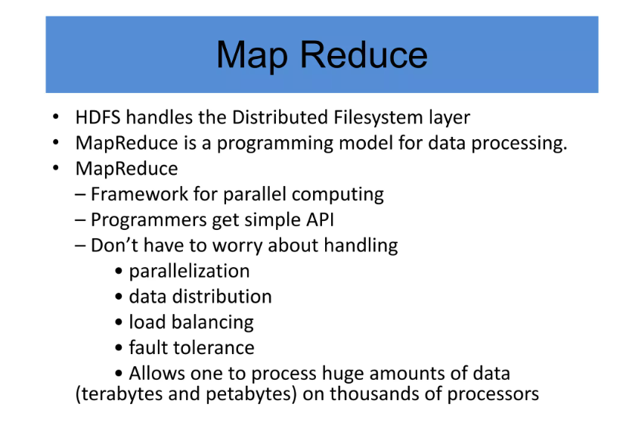
Introduction to Map Reduce

Slide 2
Definition
MapReduce is a framework using which we can write applications to process huge amounts of data, in parallel, on large clusters of commodity hardware in a reliable manner.

Slide 3
Benefits of MapReduce programming
Scalability
Hadoop is a platform that is highly scalable. This is largely because of its ability to store as well as distribute large data sets across plenty of servers.
These servers can be inexpensive and can operate in parallel.
And with each addition of servers one adds more processing power.
Contrary to the traditional relational database management systems (RDMS) that cannot scale in order to process huge amounts of data.
Hadoop MapReduce programming enables business organizations to run applications from a huge number of nodes that could involve the usage of thousands of terabytes of data.

Slide 4
Cost-effective solution
Hadoop’s highly scalable structure also implies that it comes across as a very cost-effective solution for businesses that need to store ever growing data dictated by today’s requirements
In the case of traditional relational database management systems, it becomes massively cost prohibitive to scale to the degrees possible with Hadoop, just to process data.
As such, many of the businesses would have to downsize data and further implement classifications based on assumptions of how certain data could be more valuable that the other.
In the process, raw data would have to be deleted. This basically serves short term priorities, and if a business happens to change its plans somewhere down the line, the complete set of raw data would be unavailable for later usage.
Hadoop’s scale-out architecture with MapReduce programming, allows the storage and processing of data in a very affordable manner. It can also be used in later times.
In fact, the cost savings are massive and costs can reduce from thousands and figures to hundred figures for every terabyte of data.

Slide 5
Flexibility
Business organizations can make use of Hadoop MapReduce programming to have access to various new sources of data and also operate on different types of data, whether they are structured or unstructured.
This allows them to generate value from all of the data that can be accessed by them.
Along such lines, Hadoop offers support for numerous languages that can be used for data processing and storage.
Whether the data source is social media, email, or clickstream, MapReduce can work on all of them.
Also, Hadoop MapReduce programming allows for many applications, such as recommendation systems, processing of logs, marketing analysis, warehousing of data and fraud detection.

Slide 6
Fast
Hadoop uses a storage method known as distributed file system, which basically implements a mapping system to locate data in a cluster.
The tools used for data processing, such as MapReduce programming, are also generally located in the very same servers, which allows for faster processing of data.
Even if you happen to be dealing with large volumes of data that is unstructured, Hadoop MapReduce takes minutes to process terabytes of data, and hours for petabytes of data.

Slide 7
Security and Authentication
Security is a vital aspect of any application. If any unlawful person or organization had access to multiple petabytes of your organization’s data, it can do you massive harm in terms of business dealings and operations.
In this regard, MapReduce works with HDFS and HBase security that allows only approved users to operate on data stored in the system.
Parallel processing
One of the primary aspects of the working of MapReduce programming is that it divides tasks in a manner that allows their execution in parallel.
Parallel processing allows multiple processors to take on these divided tasks, such that they run entire programs in less time.

Slide 8
Availability and resilient nature
When data is sent to an individual node in the entire network, the very same set of data is also forwarded to the other numerous nodes that make up the network.
Thus, if there is any failure that affects a particular node, there are always other copies that can still be accessed whenever the need may arise.
This always assures the availability of data.
One of the biggest advantages offered by Hadoop is that of its fault tolerance.
Hadoop MapReduce has the ability to quickly recognize faults that occur and then apply a quick and automatic recovery solution. This makes it a game changer when it comes to big data processing.

Slide 9
Simple model of programming
Among the various advantages that Hadoop MapReduce offers, one of the most important ones is that it is based on a simple programming model.
This basically allows programmers to develop MapReduce programs that can handle tasks with more ease and efficiency.
The programs for MapReduce can be written using Java, which is a language that isn’t very hard to pickup and is also used widespread.
Thus, it is easy for people to learn and write programs that meets their data processing needs sufficiently.

Slide 10
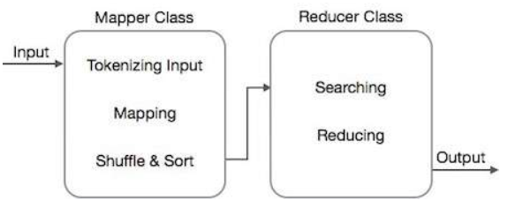
MapReduce - Algorithm
The MapReduce algorithm contains two important tasks, namely Map and Reduce.
The map task is done by means of Mapper Class
The reduce task is done by means of Reducer Class.
Mapper class takes the input, tokenizes it, maps and sorts it.
The output of Mapper class is used as input by Reducer class, which in turn searches matching pairs and reduces them.

Slide 11
MapReduce implements various mathematical algorithms to divide a task into small parts and assign them to multiple systems.
In technical terms, MapReduce algorithm helps in sending the Map & Reduce tasks to appropriate servers in a cluster.
These mathematical algorithms may include the following
Sorting
Searching
Indexing
TF-IDF (TF-IDF stands for term frequency-inverse document frequency and it is a measure, used in the fields of information retrieval (IR) and machine learning, that can quantify the importance or relevance of string representations (words, phrases, lemmas, etc) in a document amongst a collection of documents (also known as a corpus).

Slide 12
Sorting
Sorting is one of the basic MapReduce algorithms to process and analyze data. MapReduce implements sorting algorithm to automatically sort the output key-value pairs from the mapper by their keys.
Sorting methods are implemented in the mapper class itself.
In the Shuffle and Sort phase, after tokenizing the values in the mapper class, the Context class (user-defined class) collects the matching valued keys as a collection.
To collect similar key-value pairs (intermediate keys), the Mapper class takes the help of RawComparator class to sort the key-value pairs.
The set of intermediate key-value pairs for a given Reducer is automatically sorted by Hadoop to form key-values (K2, {V2, V2, …}) before they are presented to the Reducer.

Slide 13
Searching
Searching plays an important role in MapReduce algorithm.
It helps in the combiner phase (optional) and in the Reducer phase.
Let us try to understand how Searching works with the help of an example.

Slide 14
Example
The following example shows how MapReduce employs Searching algorithm to find out the details of the employee who draws the highest salary in a given employee dataset.
Let us assume we have employee data in four different files − A, B, C, and D.
Let us also assume there are duplicate employee records in all four files because of importing the employee data from all database tables repeatedly. See the following illustration.

Slide 15
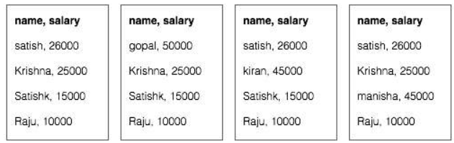
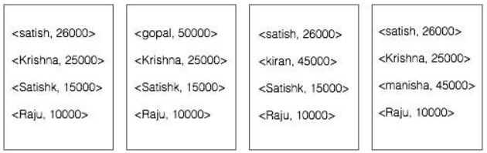
The Map phase processes each input file and provides the employee data in key-value pairs (<k, v> : <emp name, salary>). See the following illustration.

Slide 16
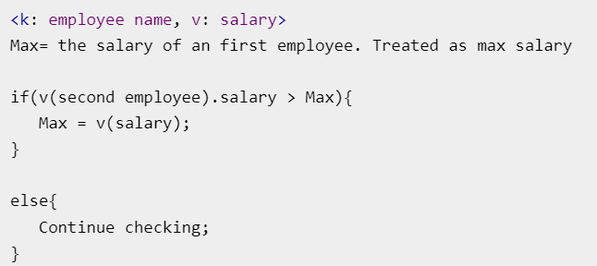
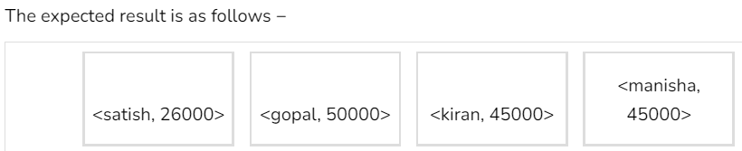
The combiner phase (searching technique) will accept the input from the Map phase as a key-value pair with employee name and salary.
Using searching technique, the combiner will check all the employee salary to find the highest salaried employee in each file. See the following snippet.

Slide 17
Reducer phase − Form each file, you will find the highest salaried employee. To avoid redundancy, check all the <k, v> pairs and eliminate duplicate entries, if any.
The same algorithm is used in between the four <k, v> pairs, which are coming from four input files.
The final output should be as follows −
<gopal, 50000>
Indexing
Normally indexing is used to point to a particular data and its address. It performs batch indexing on the input files for a particular Mapper.
The indexing technique that is normally used in MapReduce is known as inverted index.
Search engines like Google and Bing use inverted indexing technique. Let us try to understand how Indexing works with the help of a simple example.

Slide 18
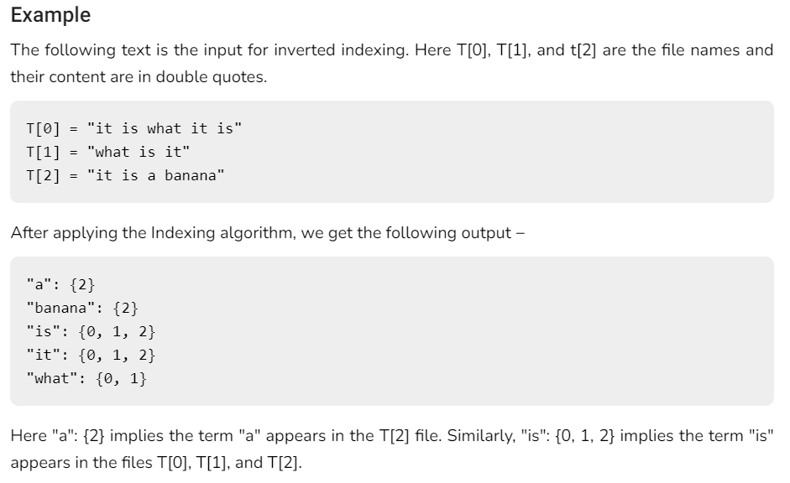

Slide 19
TF-IDF
TF-IDF is a text processing algorithm which is short for Term Frequency − Inverse Document Frequency. It is one of the common web analysis algorithms. Here, the term 'frequency' refers to the number of times a term appears in a document.
Term Frequency (TF)
It measures how frequently a particular term occurs in a document. It is calculated by the number of times a word appears in a document divided by the total number of words in that document.
TF(the) = (Number of times term the ‘the’ appears in a document) / (Total number of terms in the document) Inverse Document Frequency (IDF)
It measures the importance of a term. It is calculated by the number of documents in the text database divided by the number of documents where a specific term appears.
While computing TF, all the terms are considered equally important. That means, TF counts the term frequency for normal words like “is”, “a”, “what”, etc. Thus we need to know the frequent terms while scaling up the rare ones, by computing the following −
IDF(the) = log_e(Total number of documents / Number of documents with term ‘the’ in it).

Slide 20
Example
Consider a document containing 1000 words, wherein the word hive appears 50 times. The TF for hive is then (50 / 1000) = 0.05.
Now, assume we have 10 million documents and the word hive appears in 1000 of these. Then, the IDF is calculated as log(10,000,000 / 1,000) = 4.
The TF-IDF weight is the product of these quantities − 0.05 × 4 = 0.20.

Slide 21
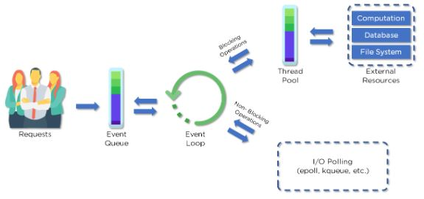
MapReduce workflow

Slide 22
MapReduce - API
We will take a close look at the classes and their methods that are involved in the operations of MapReduce programming. We will primarily keep our focus on the following −
JobContext Interface
Job Class
Mapper Class
Reducer Class

Slide 23
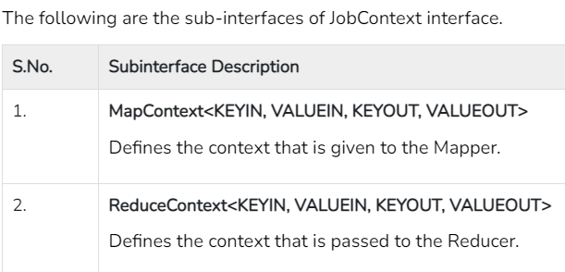
JobContext Interface
The JobContext interface is the super interface for all the classes, which defines different jobs in MapReduce.
It gives you a read-only view of the job that is provided to the tasks while they are running.
Job class is the main class that implements the JobContext interface.

Slide 24
Job Class
The Job class is the most important class in the MapReduce API.
It allows the user to configure the job, submit it, control its execution, and query the state.
The set methods only work until the job is submitted, afterwards they will throw an IllegalStateException.
Normally, the user creates the application, describes the various facets of the job, and then submits the job and monitors its progress.

Slide 25
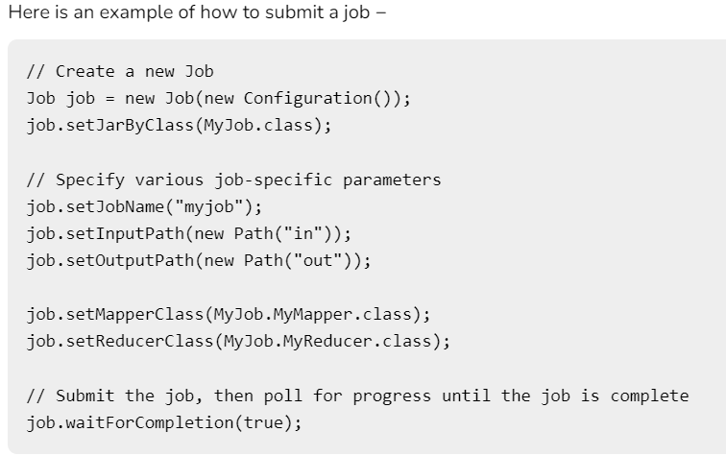

Slide 26
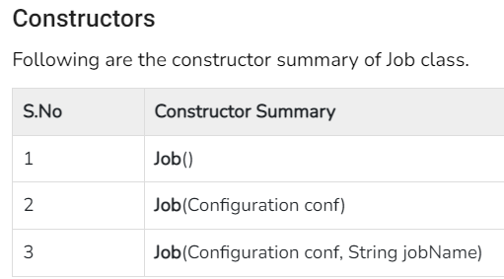
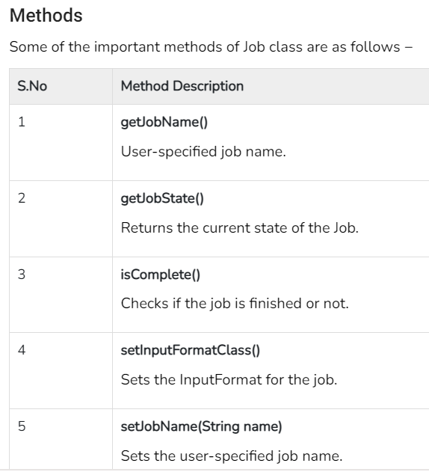
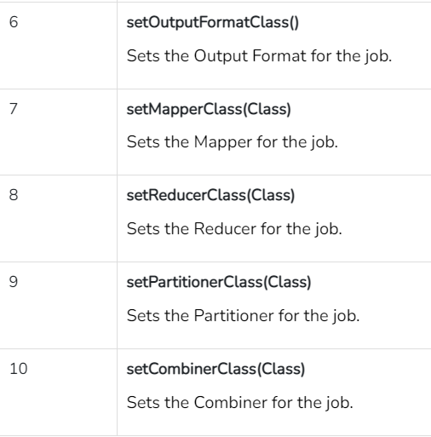

Slide 27
Mapper Class
The Mapper class defines the Map job. Maps input key-value pairs to a set of intermediate key-value pairs.
Maps are the individual tasks that transform the input records into intermediate records.
The transformed intermediate records need not be of the same type as the input records.
A given input pair may map to zero or many output pairs.
Method
map is the most prominent method of the Mapper class. The syntax is defined below −
map(KEYIN key, VALUEIN value, org.apache.hadoop.mapreduce.Mapper.Context context)This method is called once for each key-value pair in the input split.

Slide 28
Reducer Class
The Reducer class defines the Reduce job in MapReduce. It reduces a set of intermediate values that share a key to a smaller set of values.
Reducer implementations can access the Configuration for a job via the JobContext.getConfiguration() method. A Reducer has three primary phases − Shuffle, Sort, and Reduce.
Shuffle − The Reducer copies the sorted output from each Mapper using HTTP across the network.
Sort − The framework merge-sorts the Reducer inputs by keys (since different Mappers may have output the same key).
The shuffle and sort phases occur simultaneously, i.e., while outputs are being fetched, they are merged.
Reduce − In this phase the reduce (Object, Iterable, Context) method is called for each <key, (collection of values)> in the sorted inputs.

Slide 29
Method
reduce is the most prominent method of the Reducer class. The syntax is defined below −
reduce(KEYIN key, Iterable<VALUEIN> values, org.apache.hadoop.mapreduce.Reducer.Context context)This method is called once for each key on the collection of key-value pairs.

Slide 30
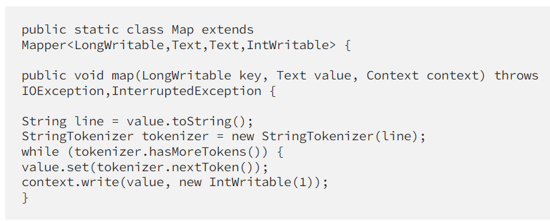
Mapper Code
We have created a class Map that extends the class Mapper which is already defined in the MapReduce Framework.
We define the data types of input and output key/value pair after the class declaration using angle brackets.
Both the input and output of the Mapper is a key/value pair.

Slide 31
Input:
The key is nothing but the offset of each line in the text file: LongWritable
The value is each individual line (as shown in the figure at the right): Text
Output:
The key is the tokenized words: Text
We have the hardcoded value in our case which is 1: IntWritable
Example — Dear 1, Bear 1, etc.
We have written a java code where we have tokenized each word and assigned them a hardcoded value equal to 1.

Slide 32
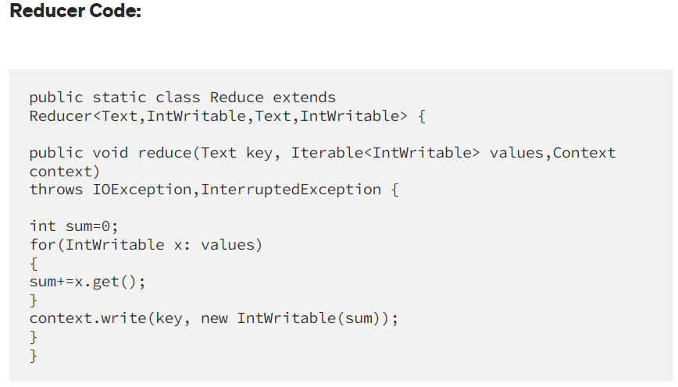
We have created a class Reduce which extends class Reducer like that of Mapper.
We define the data types of input and output key/value pair after the class declaration using angle brackets as done for Mapper.
Both the input and the output of the Reducer is a key-value pair.

Slide 33
Input:
The key nothing but those unique words which have been generated after the sorting and shuffling phase: Text
The value is a list of integers corresponding to each key: IntWritable
Example — Bear, [1, 1], etc.
Output:
The key is all the unique words present in the input text file: Text
The value is the number of occurrences of each of the unique words: IntWritable
Example — Bear, 2; Car, 3, etc.
We have aggregated the values present in each of the list corresponding to each key and produced the final answer.
In general, a single reducer is created for each of the unique words, but, you can specify the number of reducer in mapred-site.xml.

Slide 34
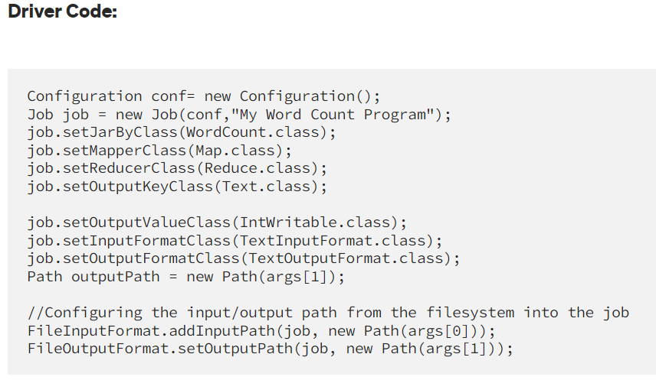

Slide 35
In the driver class, we set the configuration of our MapReduce job to run in Hadoop.
We specify the name of the job, the data type of input/output of the mapper and reducer.
We also specify the names of the mapper and reducer classes.
The path of the input and output folder is also specified.
The method setInputFormatClass () is used for specifying that how a Mapper will read the input data or what will be the unit of work. Here, we have chosen TextInputFormat so that single line is read by the mapper at a time from the input text file.
The main () method is the entry point for the driver. In this method, we instantiate a new Configuration object for the job.

Slide 36
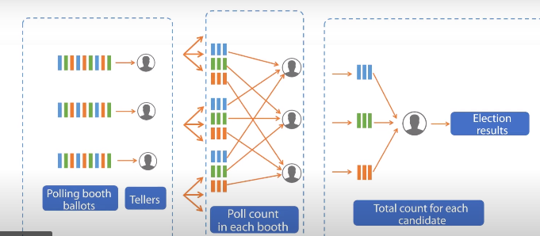

Slide 37
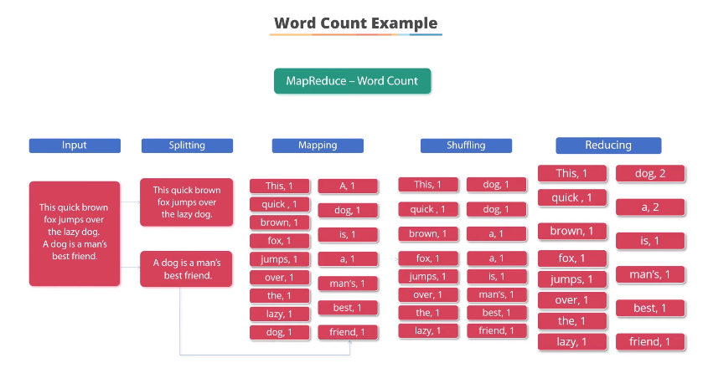

Slide 38
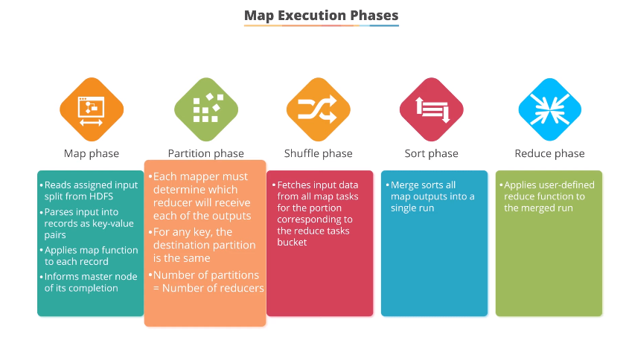

Slide 39
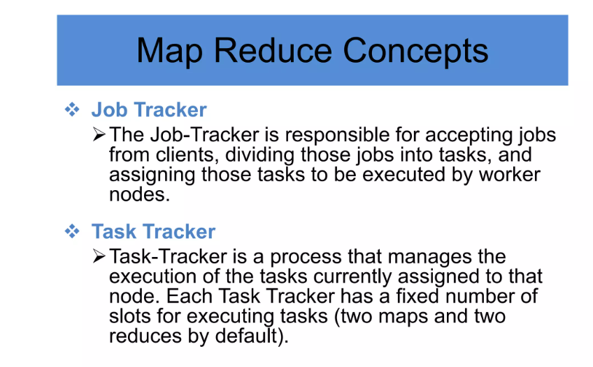

Slide 40
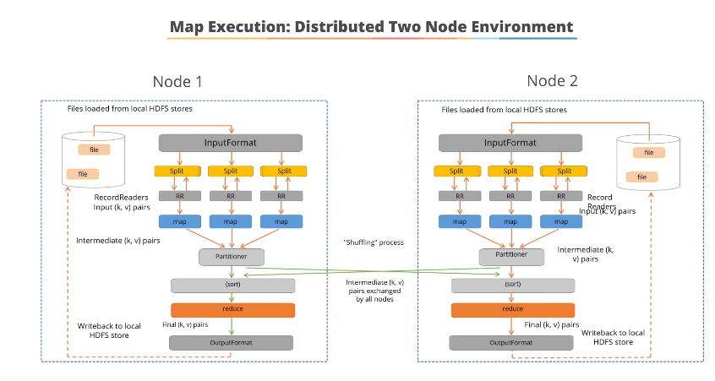

Slide 41
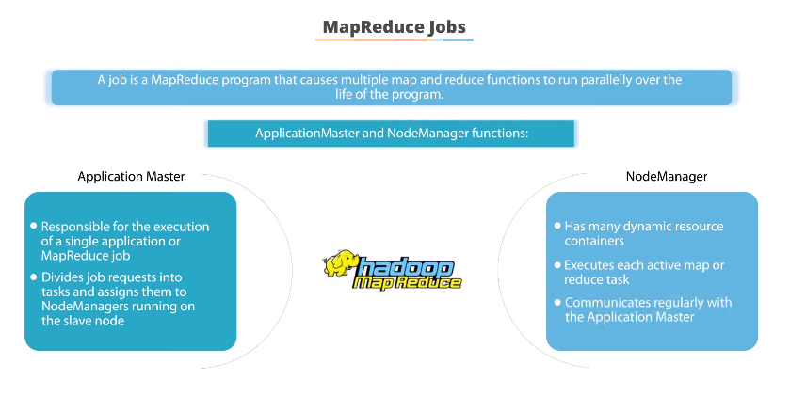

Slide 42
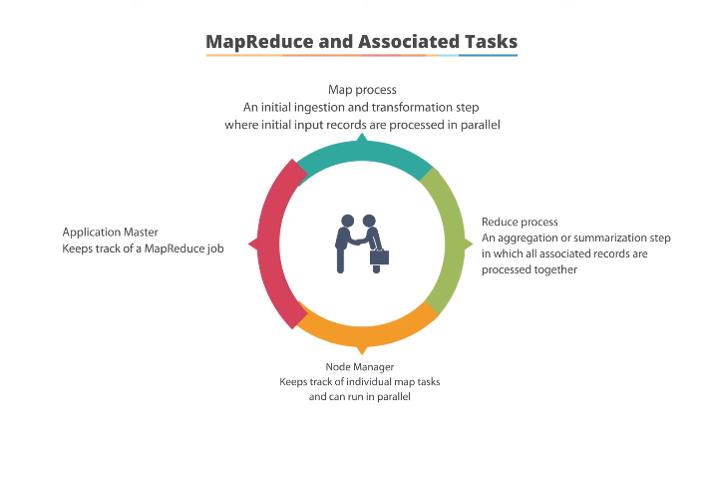

Slide 43
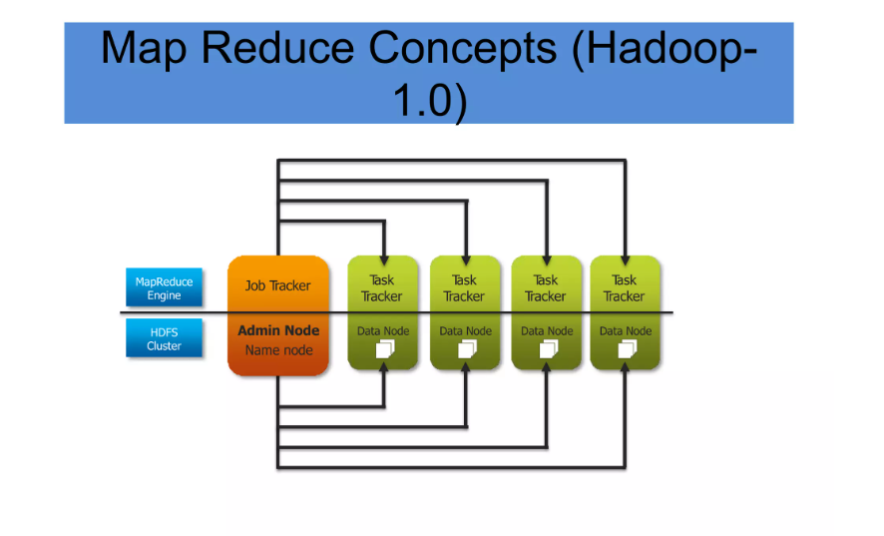

Slide 44
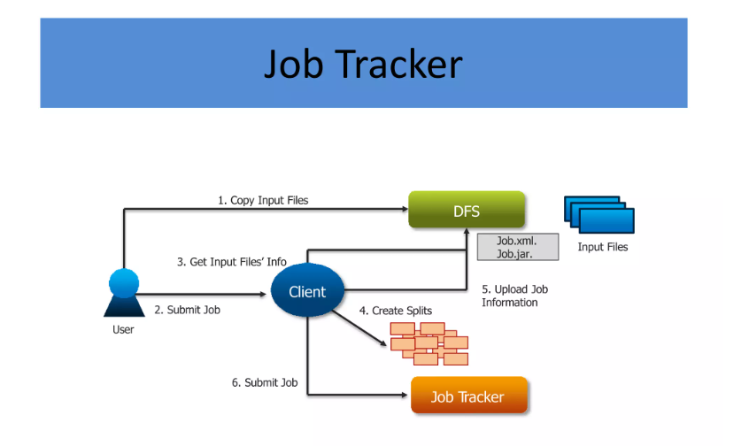

Slide 45
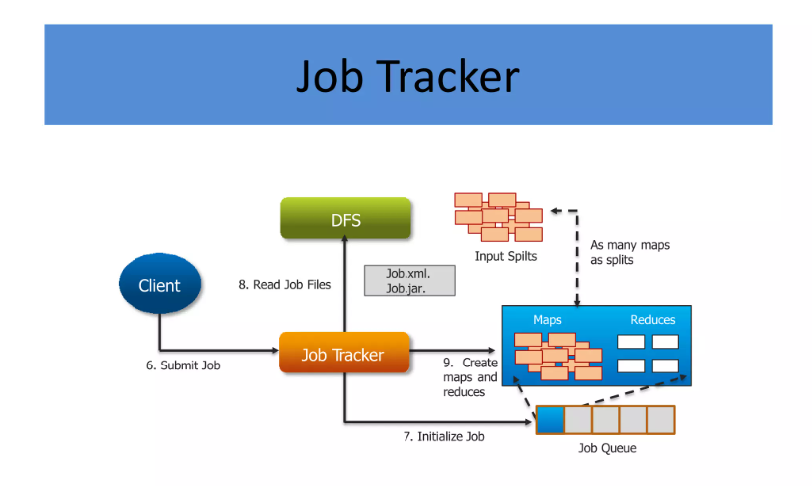

Slide 46
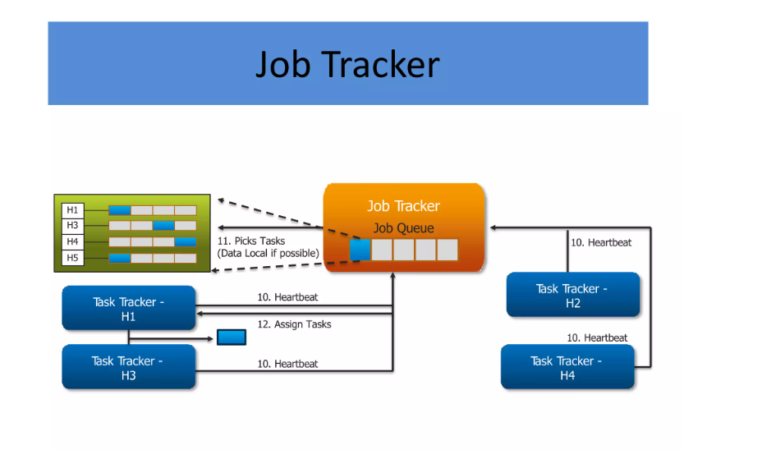

Slide 47
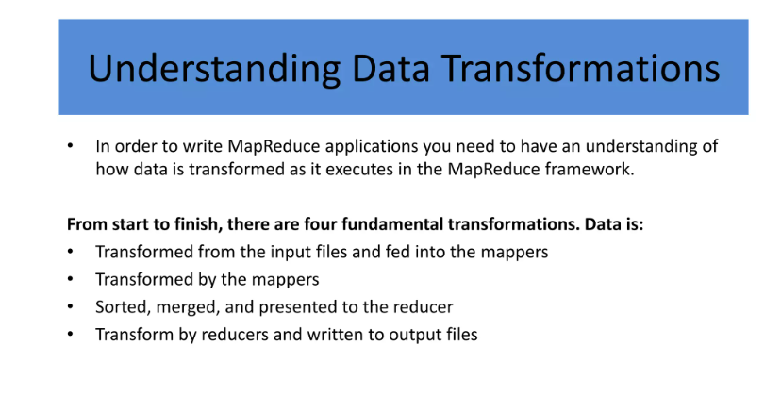

Slide 48
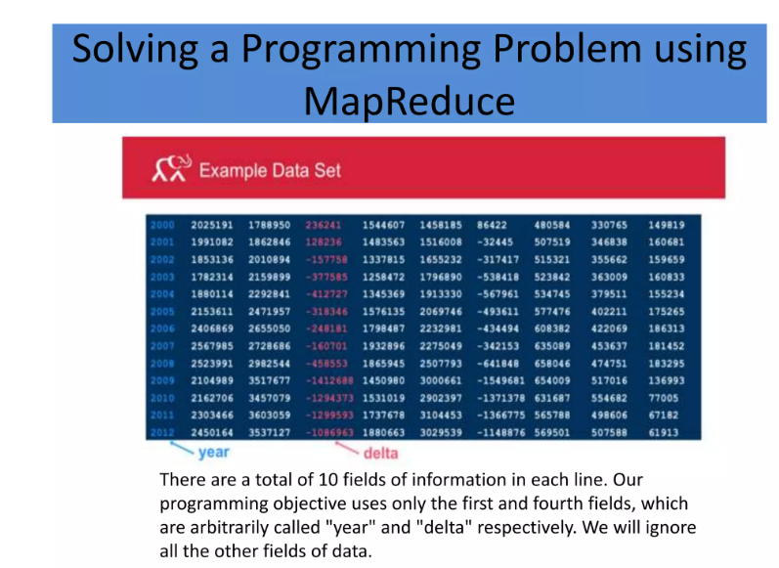

Slide 49
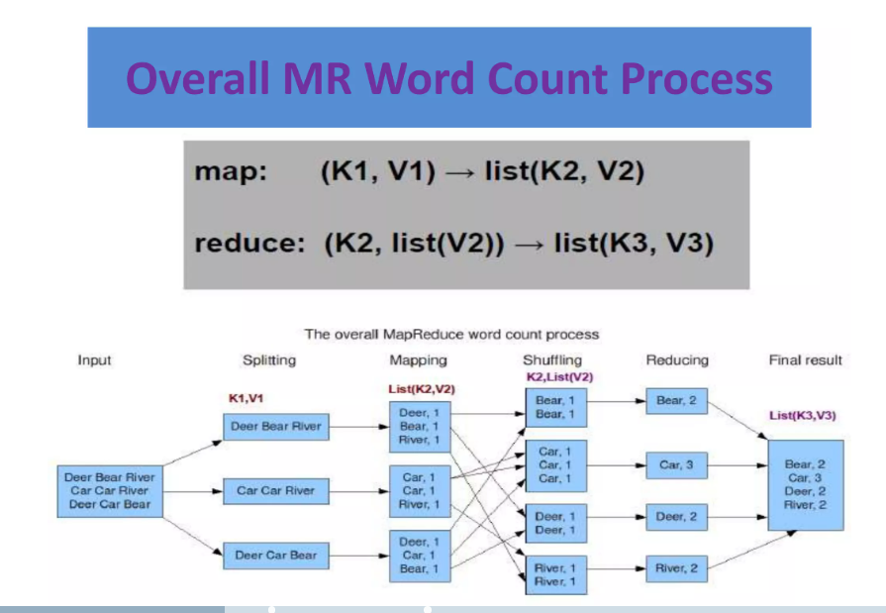

Slide 50
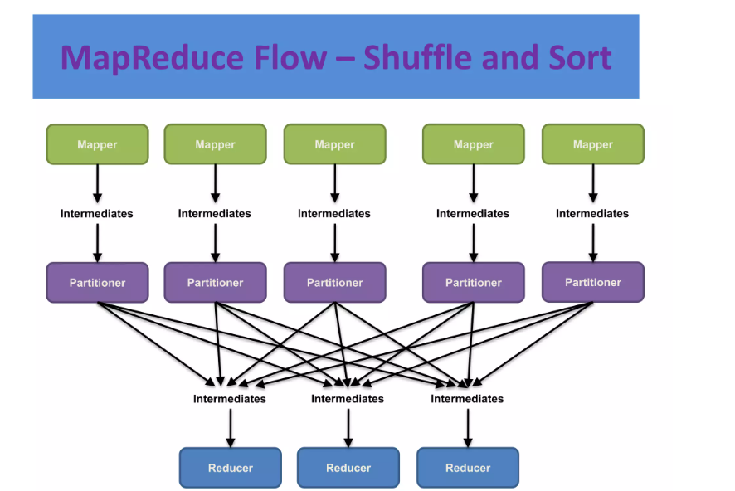

Slide 51
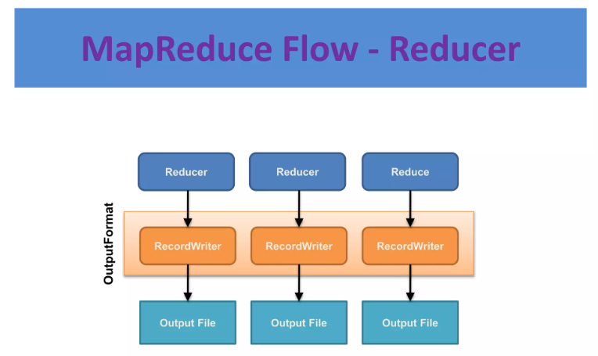

Slide 52
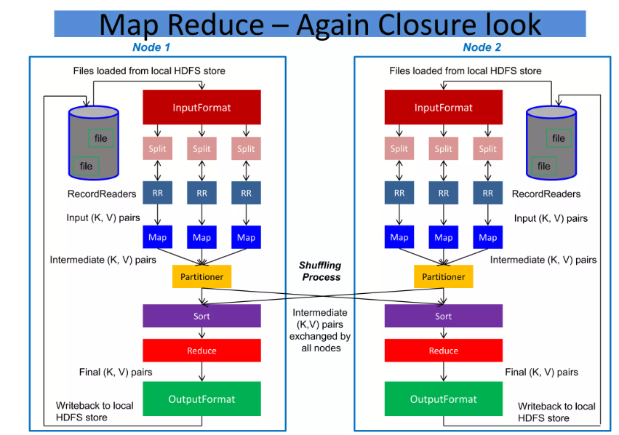

Slide 53
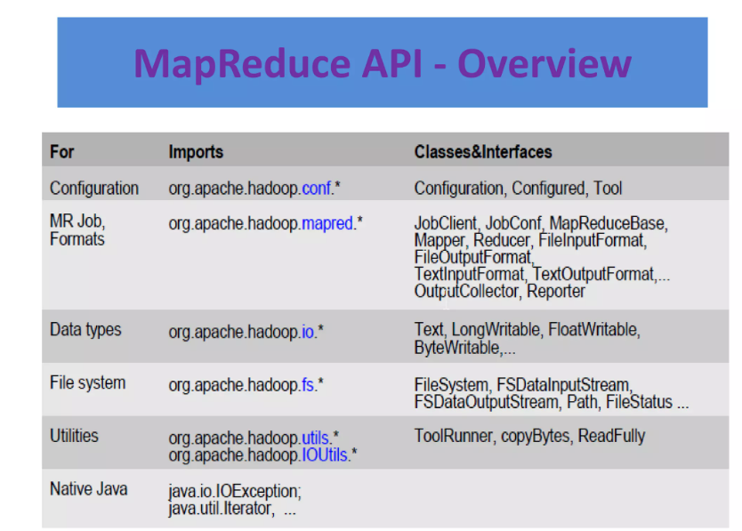

Slide 54
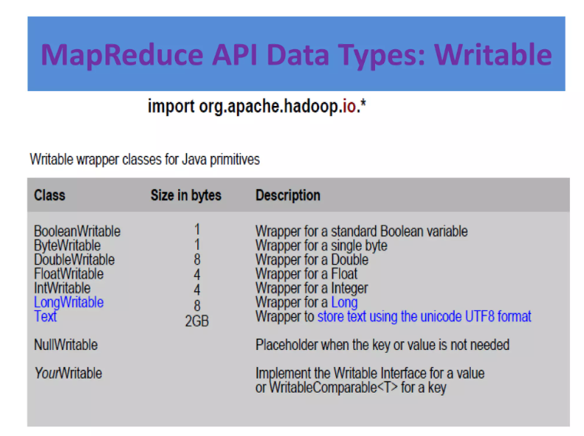

Slide 55
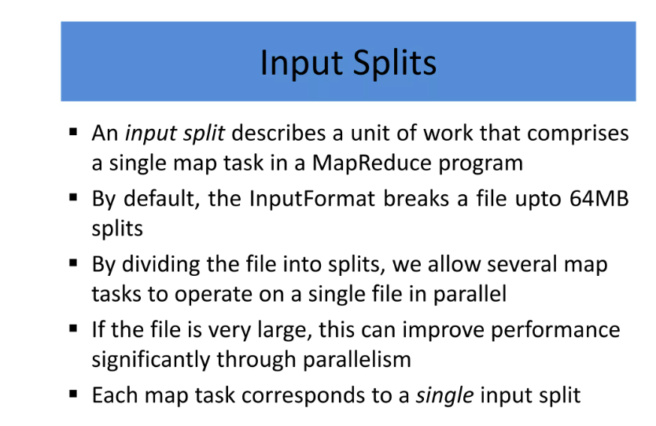

Slide 56
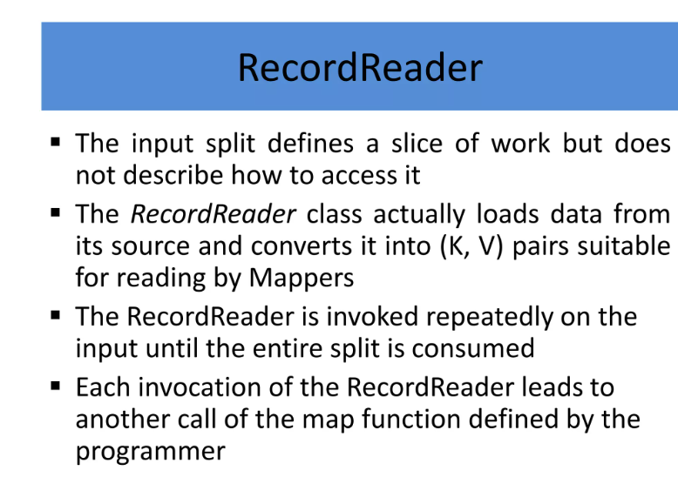

Slide 57
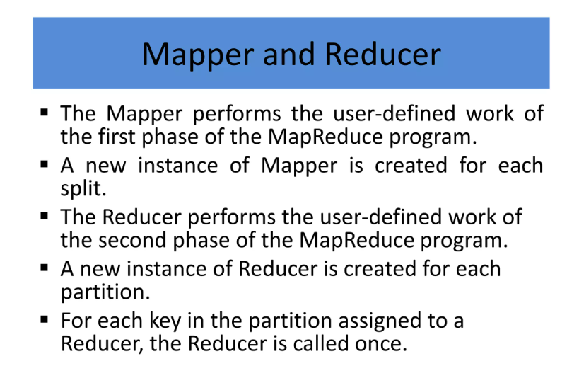

Slide 58
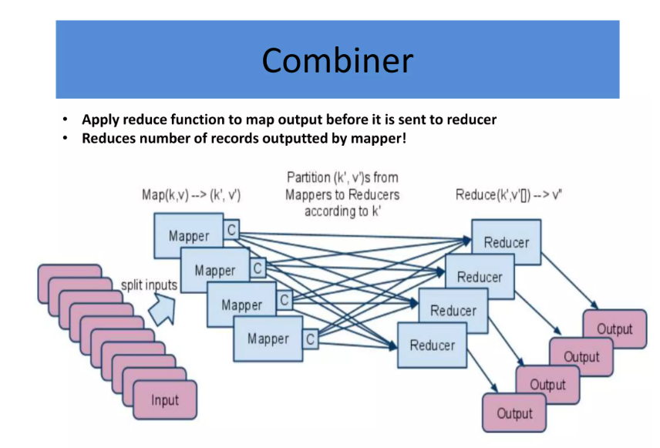

Slide 59
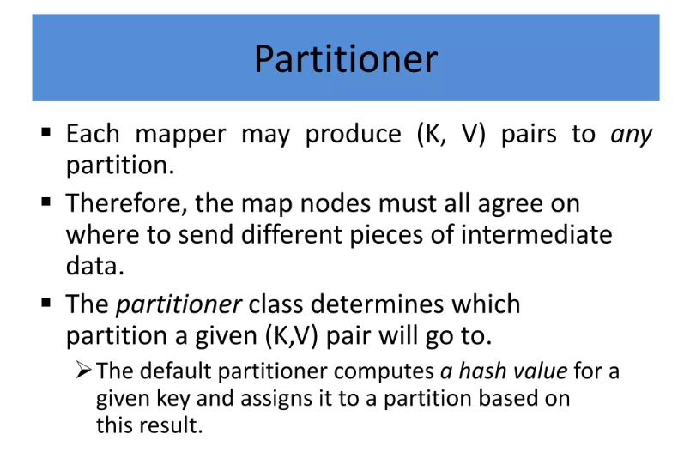

Slide 60
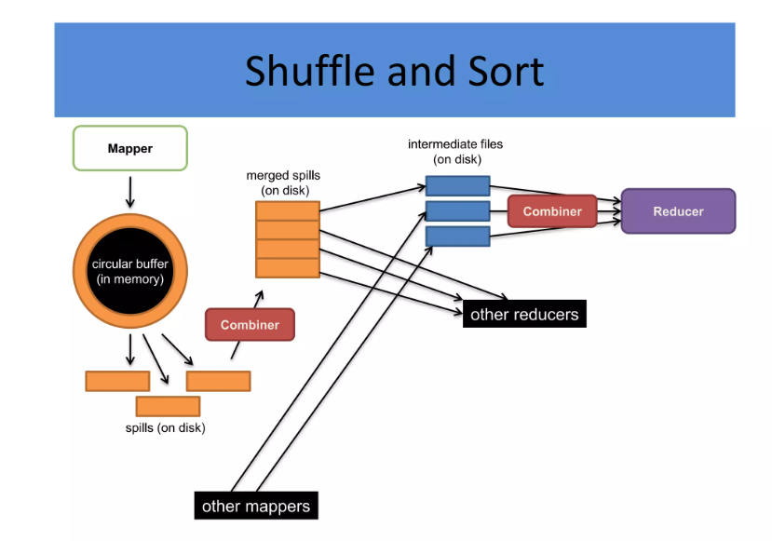

Slide 61
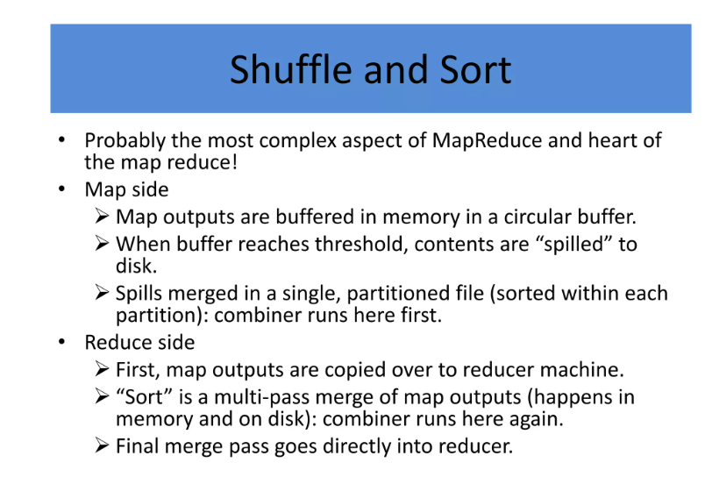

Slide 62
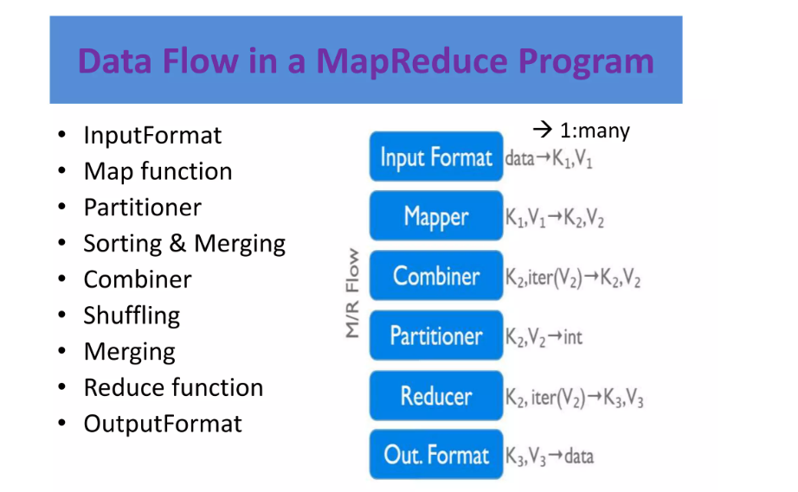

Slide 63
Why MapReduce?
Traditional Enterprise Systems normally have a centralized server to store and process data.
The following illustration depicts a schematic view of a traditional enterprise system.
Traditional model is certainly not suitable to process huge volumes of scalable data and cannot be accommodated by standard database servers.
Moreover, the centralized system creates too much of a bottleneck while processing multiple files simultaneously.

Slide 64
Hadoop is capable of running MapReduce programs written in various languages: Java, Ruby, Python, and C++.
The programs of Map Reduce in cloud computing are parallel in nature, thus are very useful for performing large-scale data analysis using multiple machines in the cluster.

Slide 65
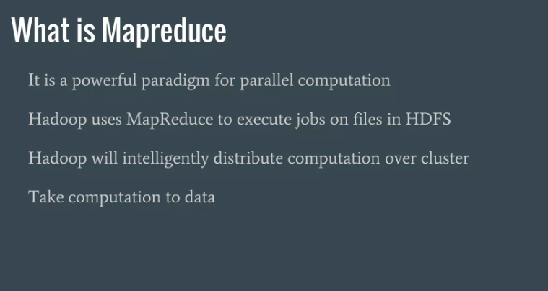

Slide 66
MapReduce is a software framework and programming model used for processing huge amounts of data.
MapReduce program work in two phases, namely, Map and Reduce.
Map tasks deal with splitting and mapping of data while Reduce tasks shuffle and reduce the data.

Slide 67
Map Reduce
Google solved this bottleneck issue using an
algorithm called MapReduce.
MapReduce divides a task into small parts and
assigns them to many computers.
Later, the results are collected at one place and
integrated to form the result dataset.

Slide 68
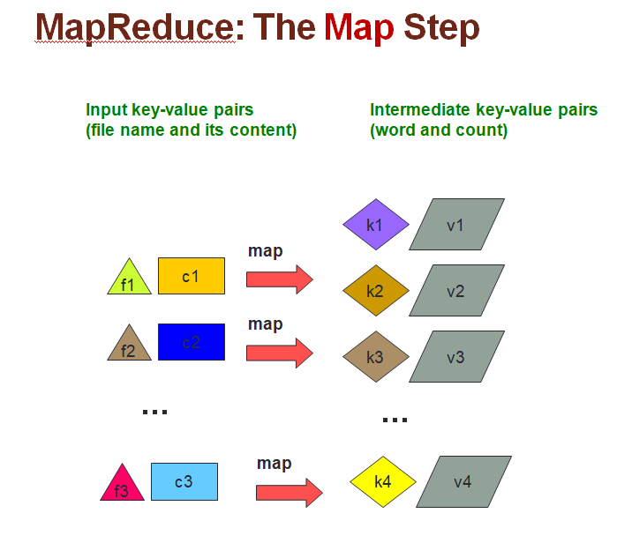

Slide 69
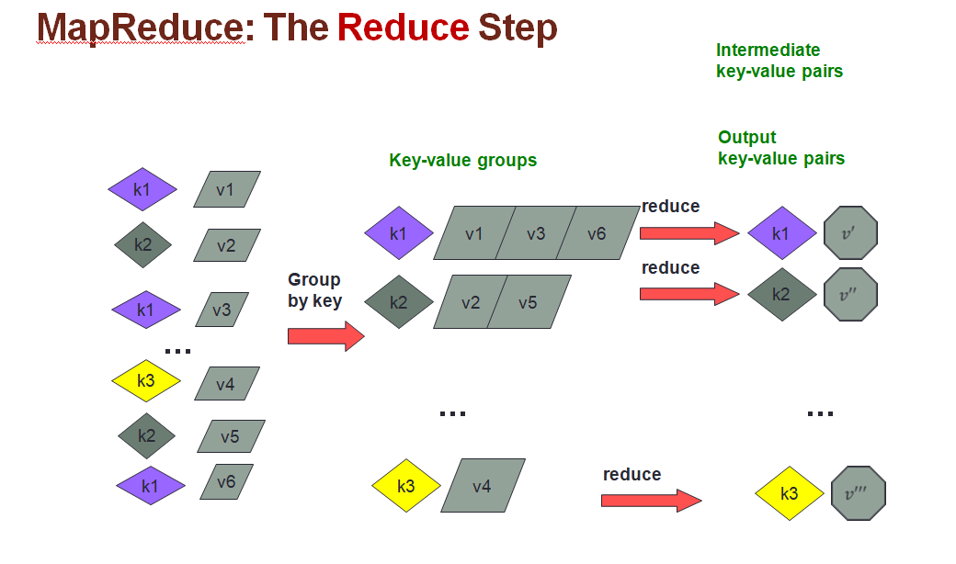

Slide 70
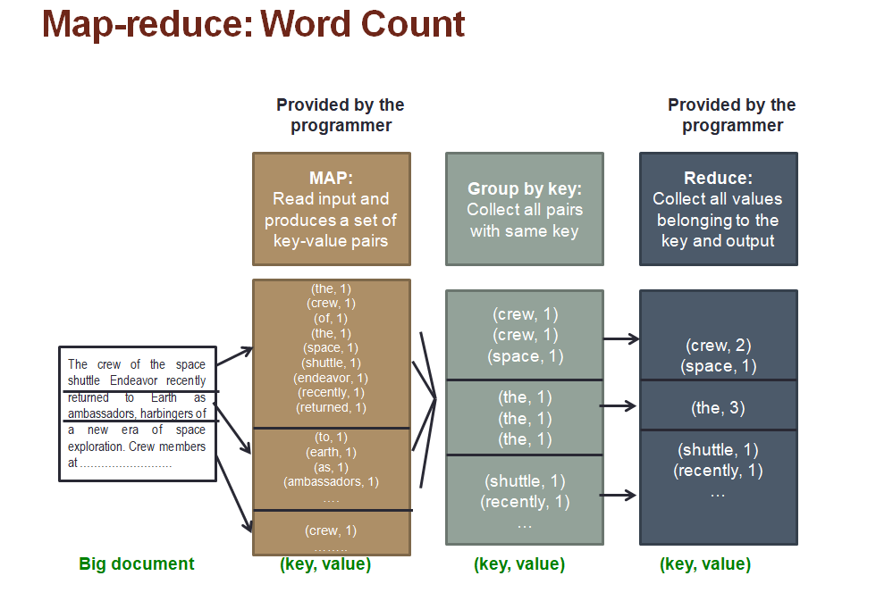

Slide 71
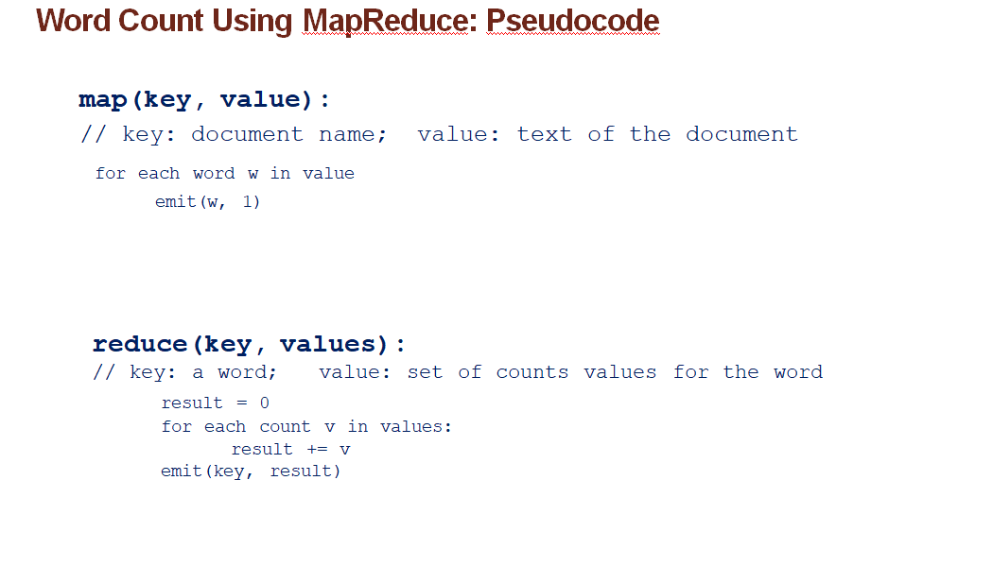

Slide 72
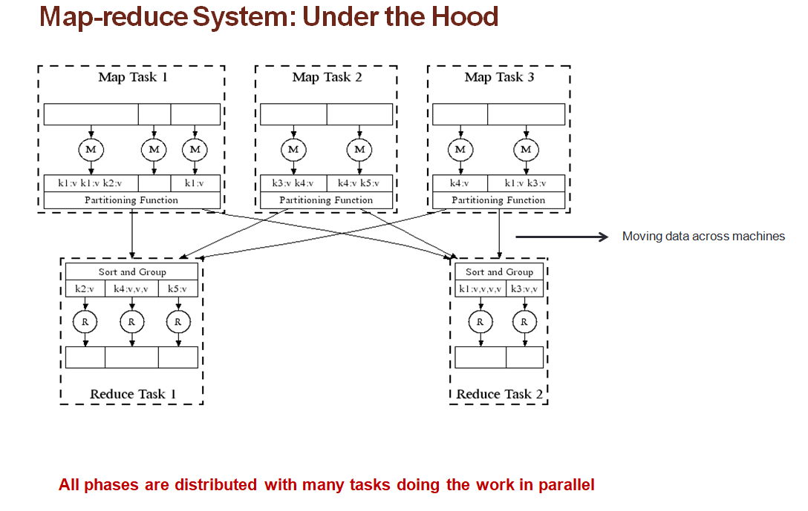

Slide 73
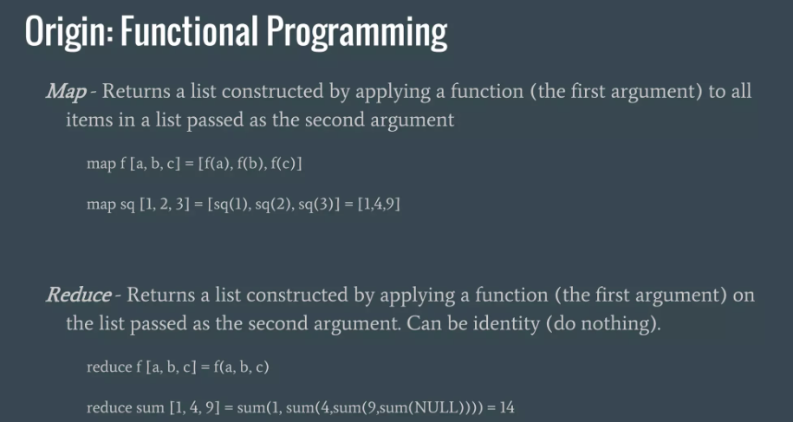

Slide 74


Slide 75


Slide 76


Slide 77


Slide 78


Slide 79


Slide 80


Slide 81


Slide 82



Slide 83
MapReduce Architecture in Big Data with Example
The whole process goes through four phases of execution namely, splitting, mapping, shuffling, and reducing.
Consider you have following input data for your MapReduce in Big data Program
Welcome to Hadoop
Class Hadoop is good
Hadoop is bad

Slide 84



Slide 85
The data goes through the following phases of MapReduce in Big Data
Input Splits:
An input to a MapReduce in Big Data job is divided into fixed-size pieces called input splits Input split is a chunk of the input that is consumed by a single map
Mapping
This is the very first phase in the execution of map-reduce program.
In this phase data in each split is passed to a mapping function to produce output values.
In our example, a job of mapping phase is to count a number of occurrences of each word from input splits (more details about input-split is given below) and prepare a list in the form of <word, frequency>

Slide 86
Shuffling
This phase consumes the output of Mapping phase. Its task is to consolidate the relevant records from Mapping phase output. In our example, the same words are clubed together along with their respective frequency.
Reducing
In this phase, output values from the Shuffling phase are aggregated. This phase combines values from Shuffling phase and returns a single output value. In short, this phase summarizes the complete dataset.
In our example, this phase aggregates the values from Shuffling phase i.e., calculates total occurrences of each word.

Slide 87
MapReduce Architecture
One map task is created for each split which then executes map function for each record in the split.
It is always beneficial to have multiple splits because the time taken to process a split is small as compared to the time taken for processing of the whole input. When the splits are smaller, the processing is better to load balanced since we are processing the splits in parallel.
However, it is also not desirable to have splits too small in size. When splits are too small, the overload of managing the splits and map task creation begins to dominate the total job execution time.
For most jobs, it is better to make a split size equal to the size of an HDFS block (which is 64 MB, by default).
Execution of map tasks results into writing output to a local disk on the respective node and not to HDFS.
Reason for choosing local disk over HDFS is, to avoid replication which takes place in case of HDFS store operation.

Slide 88
Map output is intermediate output which is processed by reduce tasks to produce the final output.
Once the job is complete, the map output can be thrown away. So, storing it in HDFS with replication becomes overkill.
In the event of node failure, before the map output is consumed by the reduce task, Hadoop reruns the map task on another node and re-creates the map output.
Reduce task doesn’t work on the concept of data locality. An output of every map task is fed to the reduce task. Map output is transferred to the machine where reduce task is running.
On this machine, the output is merged and then passed to the user-defined reduce function.
Unlike the map output, reduce output is stored in HDFS (the first replica is stored on the local node and other replicas are stored on off-rack nodes). So, writing the reduce output

Slide 89
How MapReduce Organizes Work?
Hadoop divides the job into tasks. There are two types of tasks:
Map tasks (Splits & Mapping)
Reduce tasks (Shuffling, Reducing)
The complete execution process (execution of Map and Reduce tasks, both) is controlled by two types of entities called a
Jobtracker: Acts like a master (responsible for complete execution of submitted job)
Multiple Task Trackers: Acts like slaves, each of them performing the job
For every job submitted for execution in the system, there is one Jobtracker that resides on Namenode and there are multiple tasktrackers which reside on Datanode.

Slide 90



Slide 91
A job is divided into multiple tasks which are then run onto multiple data nodes in a cluster.
It is the responsibility of job tracker to coordinate the activity by scheduling tasks to run on different data nodes.
Execution of individual task is then to look after by task tracker, which resides on every data node executing part of the job.
Task tracker’s responsibility is to send the progress report to the job tracker.
In addition, task tracker periodically sends ‘heartbeat’ signal to the Jobtracker so as to notify him of the current state of the system.
Thus job tracker keeps track of the overall progress of each job. In the event of task failure, the job tracker can reschedule it on a different task tracker.

